Slide 1
Designing Databases
13
Systems Analysis and Design, 8e
Kendall & Kendall

Slide 2
Data Storage
The data must be available when the user wants to use them.
The data must be accurate and consistent.
Efficient storage of data as well as efficient updating and retrieval
It is necessary that information retrieval be purposeful.
Notes:
Data storage is considered to be the heart of an information system.
The information obtained from the stored data must be in a form useful for managing, planning, controlling, or decision making.

Slide 3
Data Storage (Continued)
There are two approaches to the storage of data in a computer-based system:
Store the data in individual files, each unique to a particular application.
Store data in a database.
A database is a formally defined and centrally controlled store of data intended for use in many different applications.
Notes:
File system advantages:
can be designed and build rapidly
any concerns about data availability and security can be minimized
Disadvantages:
often designed only with immediate needs in mind
expensive programming time for file and program development and maintenance
stored data will be redundant
updating files is more time consuming
data integrity is an issue

Slide 4
Databases
Effectiveness objectives of the database:
Ensuring that data can be shared among users for a variety of applications (stored once)
Maintaining data that are both accurate and consistent
Ensuring data required for current and future applications will be readily available
Allowing the database to evolve as the needs of the users grow
Allowing users to construct their personal view of the data without concern for the way the data are physically stored
Notes:
A database is a central source of data meant to be shared by many users for a variety of applications.

Slide 5
Reality, Data, and Metadata
Reality
The real world
Data
Collected about people, places, or events in reality and eventually stored in a file or database
Metadata
Information that describes data

Slide 6
Reality, Data, and Metadata
Notes:
Within the realm of reality are entities are entities and attributes; within the realm of actual data are record occurrences and data item occurrences; within the real of metadata are record definitions and data item definitions.

Slide 7
Entities
Any object or event about which someone chooses to collect data
May be a person, place, or thing
May be an event or unit of time
Notes:
Examples:
a salesperson
a city
a product
machine breakdown
a sale
a month or year

Slide 8
Entity Subtype
An entity subtype is a special one-to-one relationship used to represent additional attributes, which may not be present on every record of the first entity.
This eliminates null fields stored on database tables.
For example, students who have internships: the STUDENT MASTER should not have to contain information about internships for each student.

Slide 9
Relationships
Relationships
One-to-one
One-to-many
Many-to-many
A single vertical line represents one.
A crow’s foot represents many.
Notes:
Relationships are associations between entities
Self-Join Relationship - An entity with a relationship connecting to itself

Slide 10
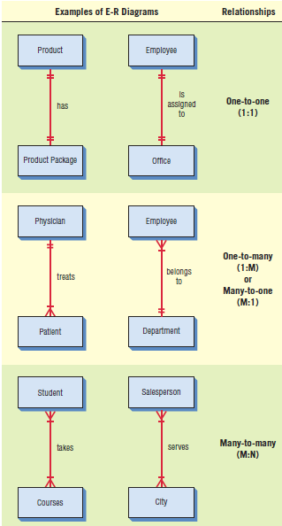
Entity-Relationship Diagrams Associations
Entity-relationship (E-R) diagrams can show one-to-one, one-to-many, or many-to-many associations.

Slide 11
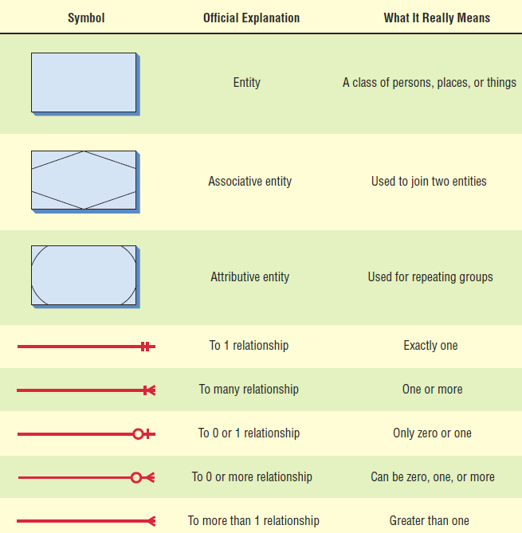
Entity-Relationship Symbols and Their Meanings
Notes:
Associative entity – used to join two entities.
Attributive entity – used for repeating groups.

Slide 12
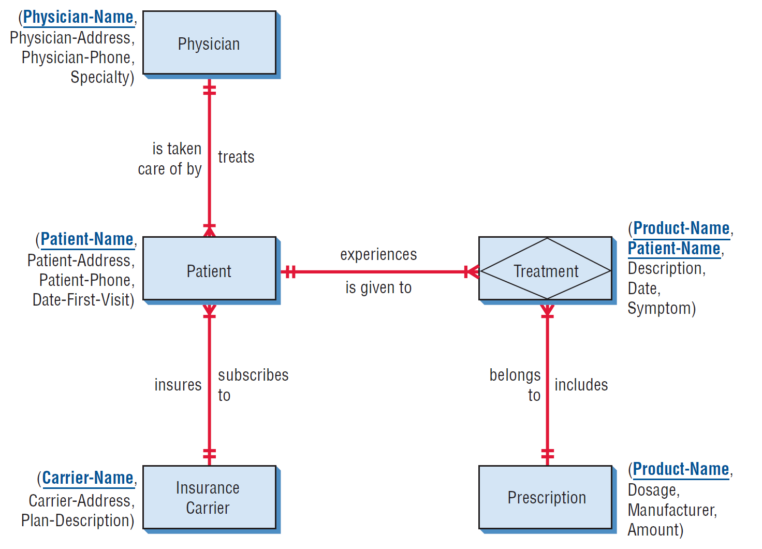
The Entity-Relationship Diagram for Patient Treatment
Attributes can be listed alongside the entities.
The key is underlined.
Notes:
The attributes are listed next to each of the entities, and the key is underlines.

Slide 13
Attributes, Records, and Keys
Attributes represent some characteristic of an entity.
Records are a collection of data items that have something in common with the entity described.
Keys are data items in a record used to identify the record.
Notes:
Data item is used interchangeably with attribute.

Slide 14
Key Types
Key types are:
Primary key—unique attribute for the record
Candidate key—an attribute or collection of attributes, that can serve as a primary key
Secondary key—a key which may not be unique, used to select a group of records
Composite key—a combination of two or more attributes representing the key (primary)
Notes:
A primary key should be minimal, and contain no extra attributes than are necessary to identify a record.

Slide 15
Metadata
Data about the data in the file or database
Describe the name given and the length assigned each data item
Also describe the length and composition of each of the records

Slide 16
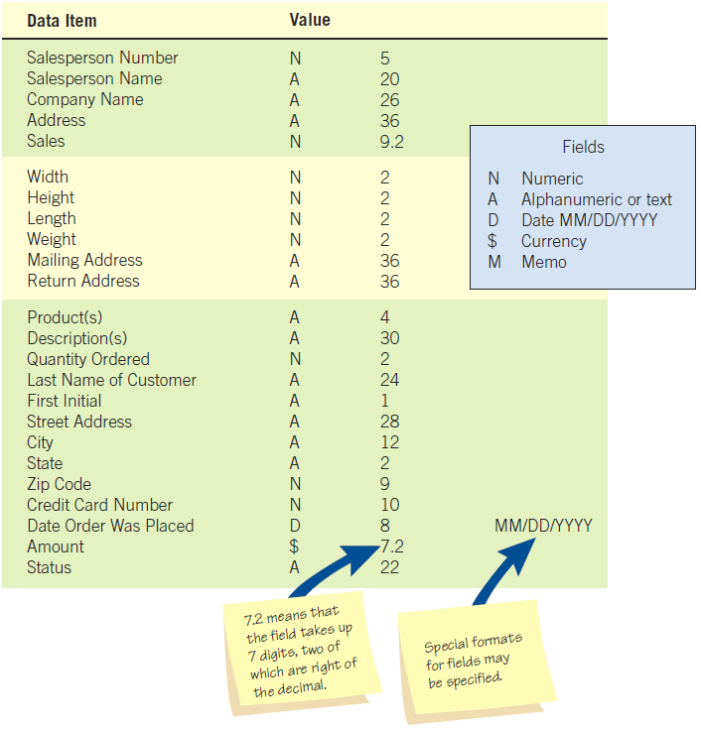
Metadata (Figure 13.7)
Metadata includes a description of what the value of each data item looks like.

Slide 17
Files
A file contains groups of records used to provide information for operations, planning, management, and decision making.
Files can be used for storing data for an indefinite period of time, or they can be used to store data temporarily for a specific purpose.

Slide 18
File Types
Master file
Table file
Transaction file
Report file

Slide 19
Master and Table Files
Master files:
Contain records for a group of entities
Contain all information about a data entity
Table files:
Contains data used to calculate more data or performance measures
Usually read-only by a program
Notes:
Each record of a Master file generally contains a primary key and several secondary keys.
Examples include patient records, customer records, a personnel file, and a parts inventory.

Slide 20
Transaction and Report Files
Transaction records:
Used to enter changes that update the master file and produce reports
Report files:
Used when it is necessary to print a report

Slide 21
Relational Databases
A database is intended to be shared by many users.
There are three structures for storing database files:
Relational database structures
Hierarchical database structures
Network database structures
Notes:
An analyst today would typically design a relational database.

Slide 22
Relational Data Structure (Figure 13.9)
In a relational data structure, data are stored in many tables.

Slide 23
Normalization
Normalization is the transformation of complex user views and data stores to a set of smaller, stable, and easily maintainable data structures.
The main objective of the normalization process is to simplify all the complex data items that are often found in user views.
Notes:
For relational tables to be useful and manageable, the relational tables must first be normalized.

Slide 24
Normalization of a Relation Is Accomplished in Three Major Steps
Notes:
Step 1: remove all repeating groups and identify the primary key – the relation needs to be broken up into two or more relations (1NF)
Step 2: remove partial dependencies – ensures that all nonkey attributes are fully dependent on the primary key. All partial dependencies are removed and placed in another relation.
Step 3: removes any transitive dependencies – one in which nonkey attributes are dependent on other nonkey attributes.

Slide 25
First Normal Form (1NF)
Remove repeating groups.
The primary key with repeating group attributes are moved into a new table.
When a relation contains no repeating groups, it is in first normal form.

Slide 26
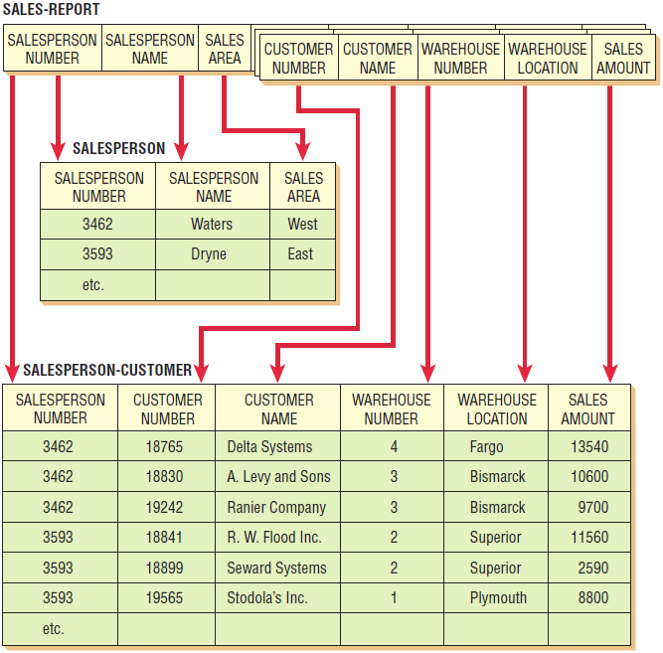
The Original Unnormalized Relation
The original unnormalized relation SALES-REPORT is separated into two relations, SALESPERSON (3NF) and SALESPERSON-CUSTOMER (1NF).

Slide 27
Second Normal Form (2NF)
Remove any partially dependent attributes and place them in another relation.
A partial dependency is when the data are dependent on a part of a primary key.
A relation is created for the data that are only dependent on part of the key and another for data that are dependent on both parts.

Slide 28
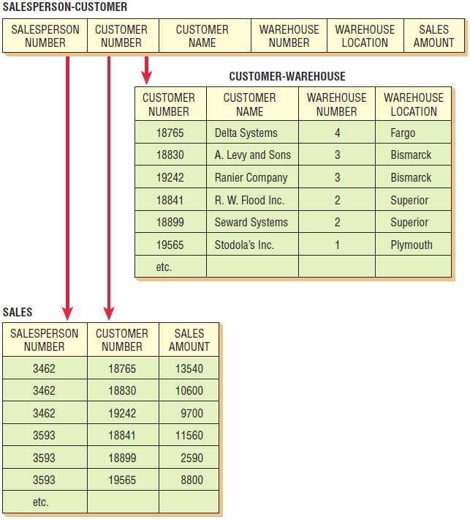
Second Normal Form
The relation SALESPERSON-CUSTOMER is separated into a relation called CUSTOMER-WAREHOUSE (2NF) and a relation called SALES (1NF).

Slide 29
Third Normal Form (3NF)
Must be in 2NF
Remove any transitive dependencies.
A transitive dependency is when non-key attributes are dependent not only on the primary key, but also on a non-key attribute.

Slide 30
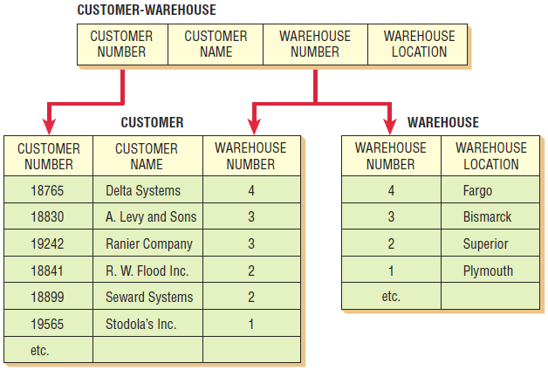
Third Normal Form
The relation CUSTOMER-WAREHOUSE is separated into two relations called CUSTOMER (1NF) and WAREHOUSE (1NF).

Slide 31
Integrity Constraints
Entity integrity
Referential integrity
Domain integrity

Slide 32
Entity Integrity
The primary key cannot have a null value.
If the primary key is a composite key, none of the fields in the key can contain a null value.

Slide 33
Referential Integrity
Referential integrity governs the nature of records in a one-to-many relationship.
Referential integrity means that all foreign keys in the “many” table (the child table) must have a matching record in the parent table.

Slide 34
Referential Integrity (Continued)
Referential integrity implications:
You cannot add a record in the child (many) table without a matching record in the parent table.
You cannot change a primary key that has matching child table records.
You cannot delete a record that has child records.

Slide 35
Referential Integrity (Continued)
Implemented in two ways:
A restricted database updates or deletes a key only if there are no matching child records.
A cascaded database will delete or update all child records when a parent record is deleted or changed.

Slide 36
Domain Integrity
Domain integrity rules are used to validate the data.
Domain integrity has two forms:
Check constraints, which are defined at the table level.
Rules, which are defined as separate objects and can be used within a number of fields.

Slide 37
Anomalies
Data redundancy
Insert anomaly
Deletion anomaly
Update anomaly

Slide 38
Data Redundancy
When the same data is stored in more than one place in the database
Solved by creating tables that are in third normal form

Slide 39
Insert Anomaly
Occurs when the entire primary key is not known and the database cannot insert a new record, which would violate entity integrity
Can be avoided by using a sequence number for the primary key

Slide 40
Deletion Anomaly
Happens when a record is deleted that results in the loss of other related data

Slide 41
Update Anomaly
When a change to one attribute value causes the database to either contain inconsistent data or causes multiple records to need changing
May be prevented by making sure tables are in third normal form

Slide 42
Denormalization
Denormalization is the process of taking the logical data model and transforming it into an efficient physical model.

Slide 43
Data Warehouses
Used to organize information for quick and effective queries

Slide 44
Data Warehouses and Database Differences
In the data warehouse, data are organized around major subjects.
Data in the warehouse are stored as summarized rather than detailed raw data.
Data in the data warehouse cover a much longer time frame than in a traditional transaction-oriented database.
Data warehouses are organized for fast queries (complex ones as well).

Slide 45
Data Warehouses and Database Differences (Continued)
Data warehouses allow for easy access via data-mining software.
Data warehouses include multiple databases that have been processed so that data are uniformly defined.
Data warehouses usually include data from outside sources.

Slide 46
Online Analytic Processing
Online analytic processing (OLAP) is meant to answer decision makers’ complex questions by defining a multidimensional database.

Slide 47
Data Mining
Data mining, or knowledge data discovery (KDD), is the process of identifying patterns that a human is unable to detect.

Slide 48
Data-Mining Patterns
Associations—patterns that occur together
Sequences—patterns of actions that take place over a period of time
Clustering—patterns that develop among groups of people
Trends—the patterns that are noticed over a period of time

Slide 49
Data Mining
Data mining collects personal information about customers in an effort to be more specific in interpreting and anticipating their preferences.

Slide 50
Data-Mining Problems
Costs may be too high to justify
Has to be coordinated
Ethical aspects

